Slide 1
Blueprint: A Framework for Collaborative Success
Requirements Specification & Technical Roadmap
Isaac Trejo Mendoza, Jacob McPherson, Jeongha Park, and Obadiah Sieg

Slide 2
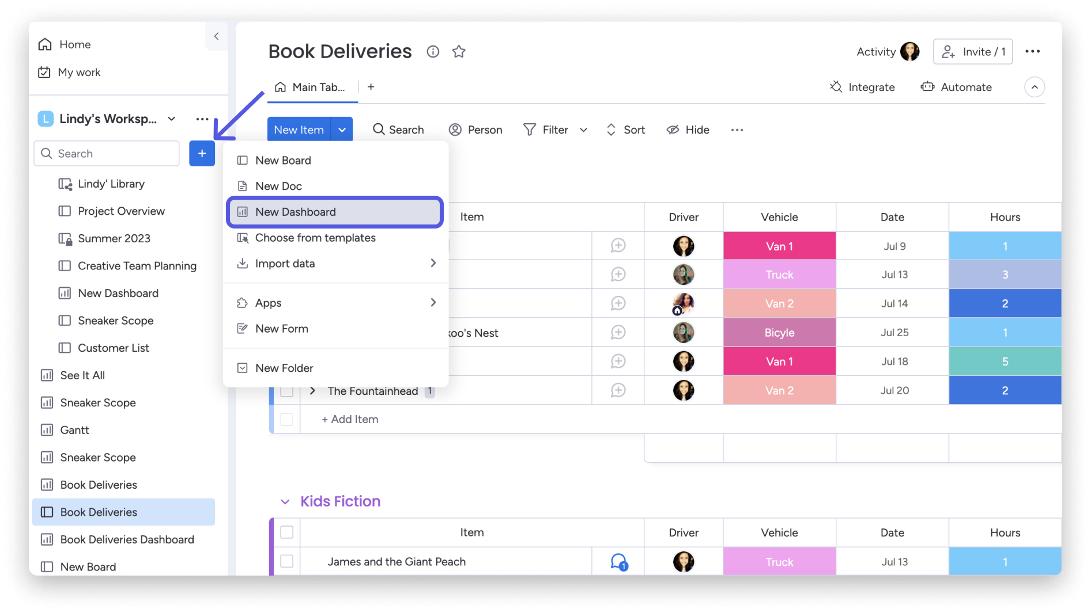
Notes:
Bad design examples

Slide 3
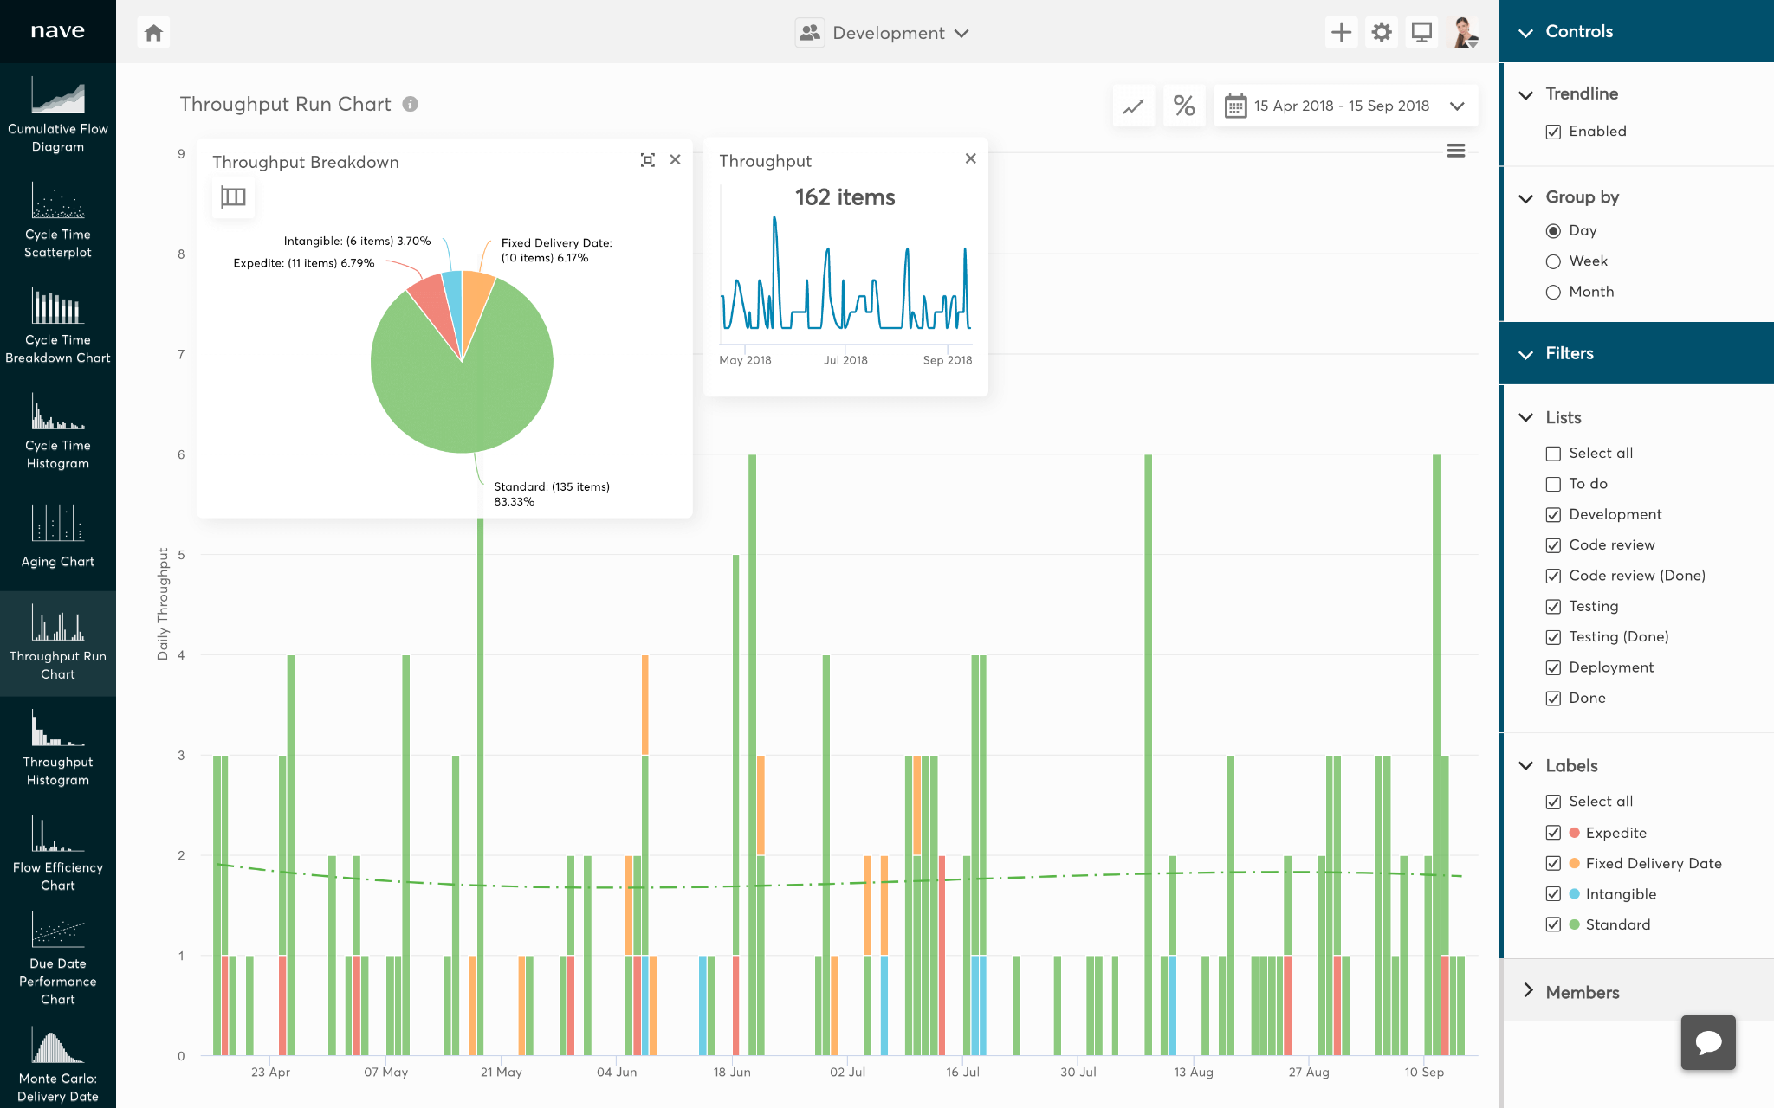
Notes:
Bad design example

Slide 4
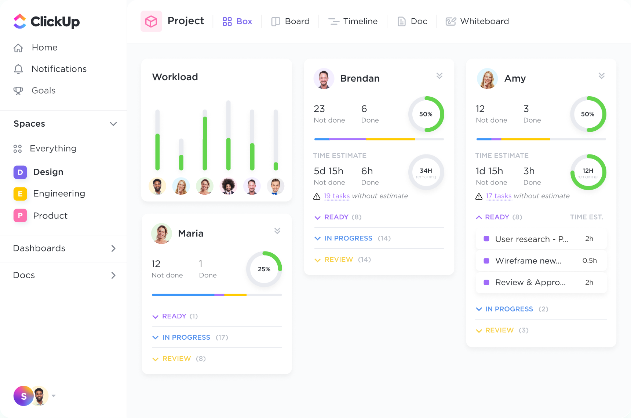
Notes:
Bad example, no calendar, too complicated

Slide 5
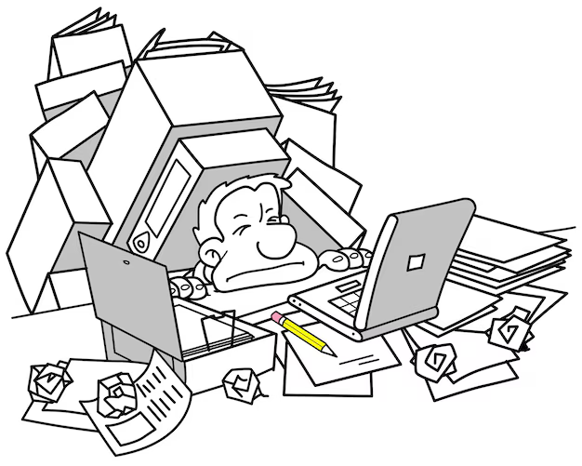
Introduction
The problem: group projects are typically hard to manage in a group setting and the tools out there are far too complicated to warrant using them in the first place.
The solution: a simple project management web application that is free to use and compares everyone’s schedules to find the best time for them to meet and collaborate on group projects.
The core philosophy: minimalist and student focused.
Gamification elements to keep the users motivated and consistent with the project’s management

Slide 6
Overview
Tools & Technologies
Project Requirements
Tentative Schedule

Slide 7
Tools & Technologies
React
Front end with a component-based, reactive U.I.
Supabase
Back end for a real time database and Google OAuth 2.0.
Vercel
Back end, hosting, and deployment of the website.
Figma
Design and rapid inspiration of the G.U.I.

Slide 8
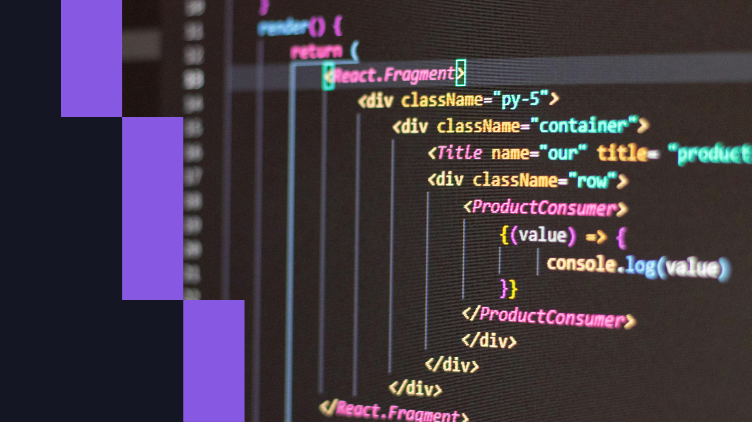

Front End

Slide 9
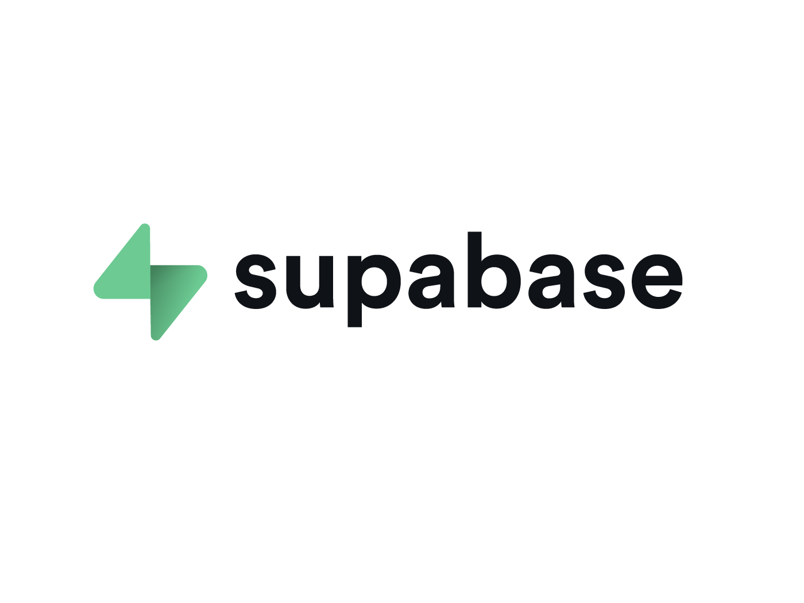
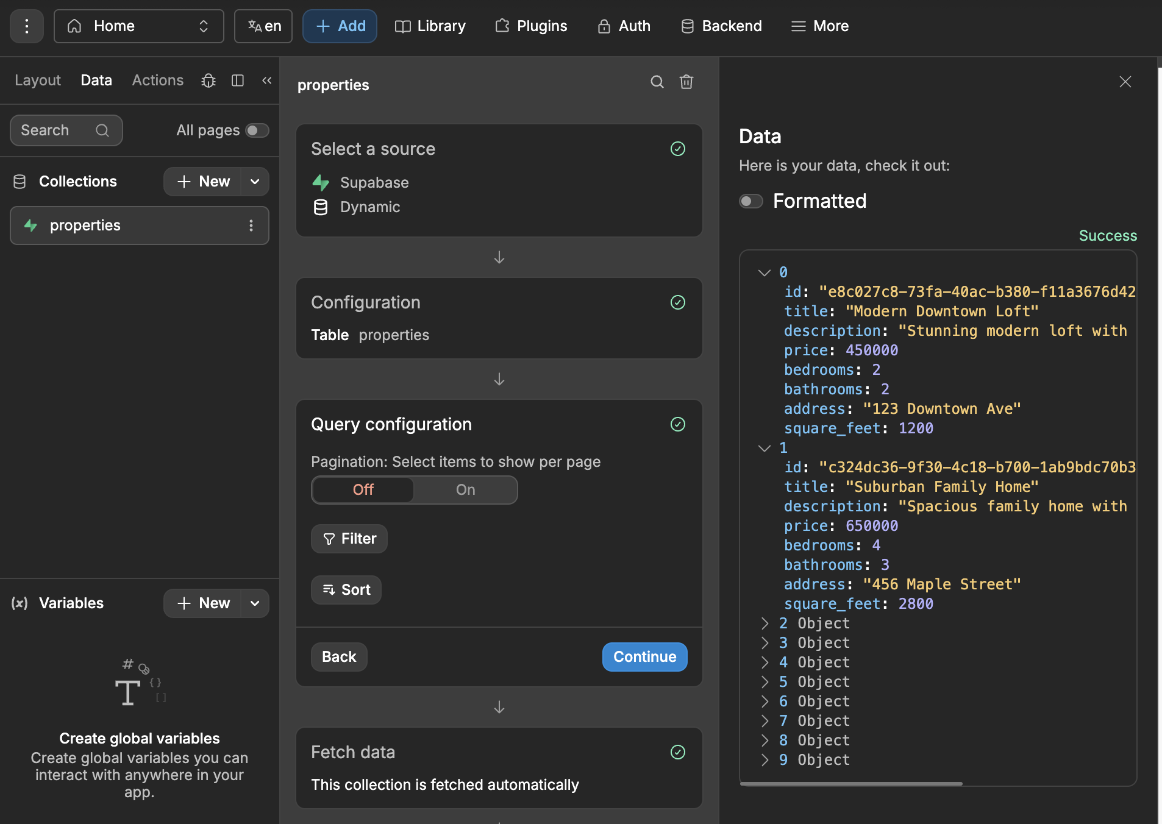
Back End

Slide 10
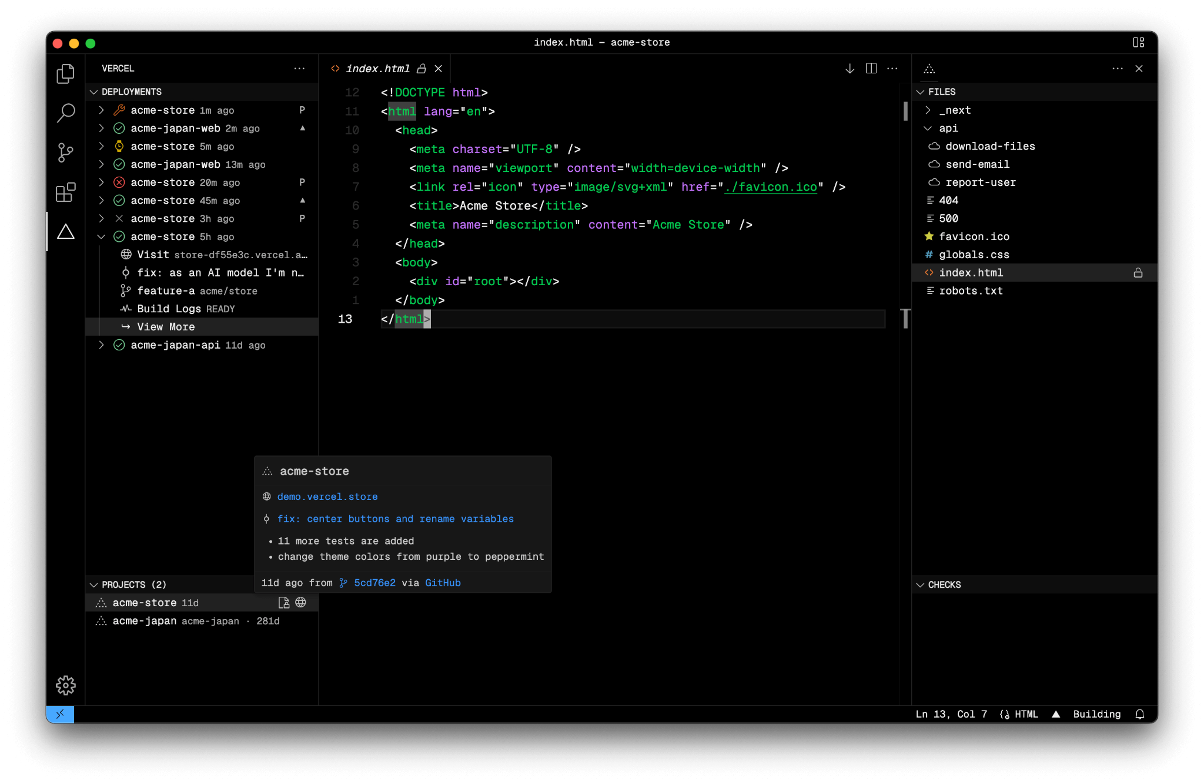

Server

Slide 11
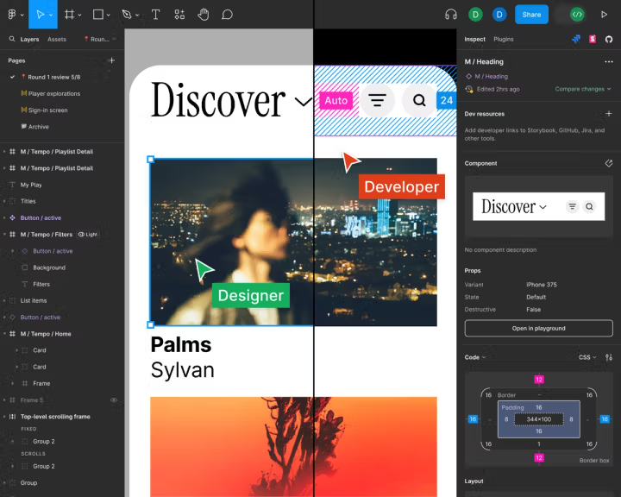
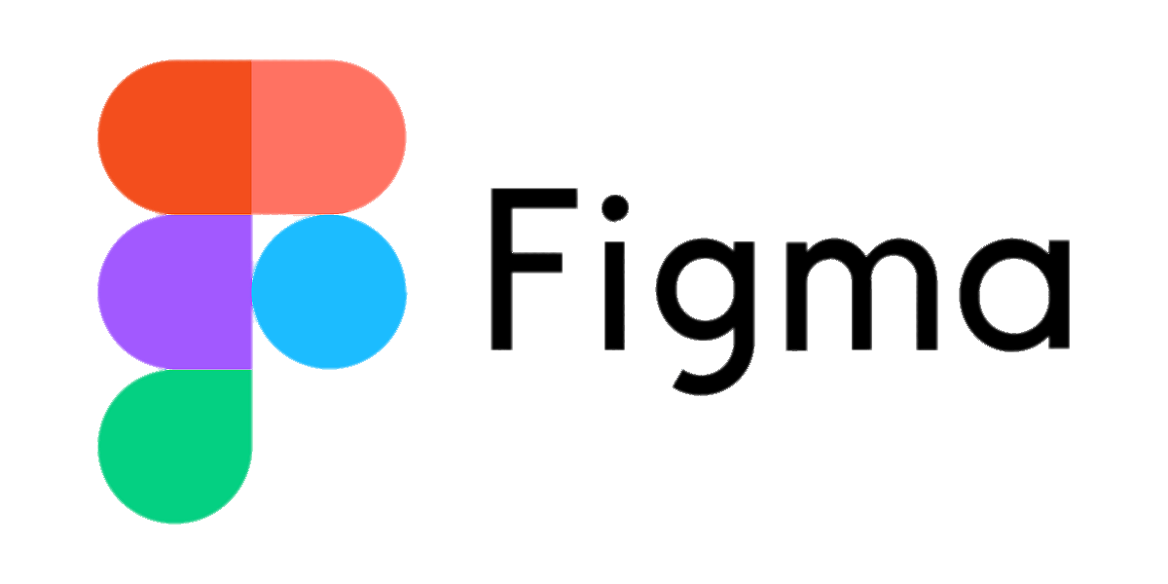
Additional Tools

Slide 12
Project Requirements
Task Management Component
Calendar Component
Notification System
Design: examples and non examples
Dashboard

Slide 13
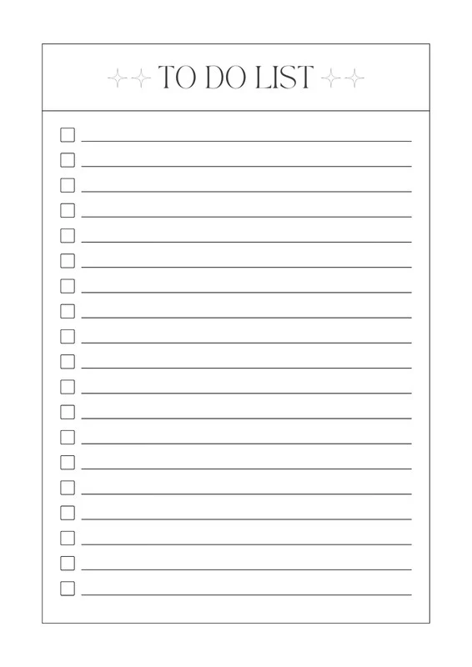
Task Management Component
A dynamic task list: gives the user the ability to view the tasks, the members assigned to them, and their priority at a glance.
Color-coded priorities: red for high, orange for medium, white for low, and green for completed tasks.
Completion animation for when a task is finished.
A “Past Tasks” view

Slide 14
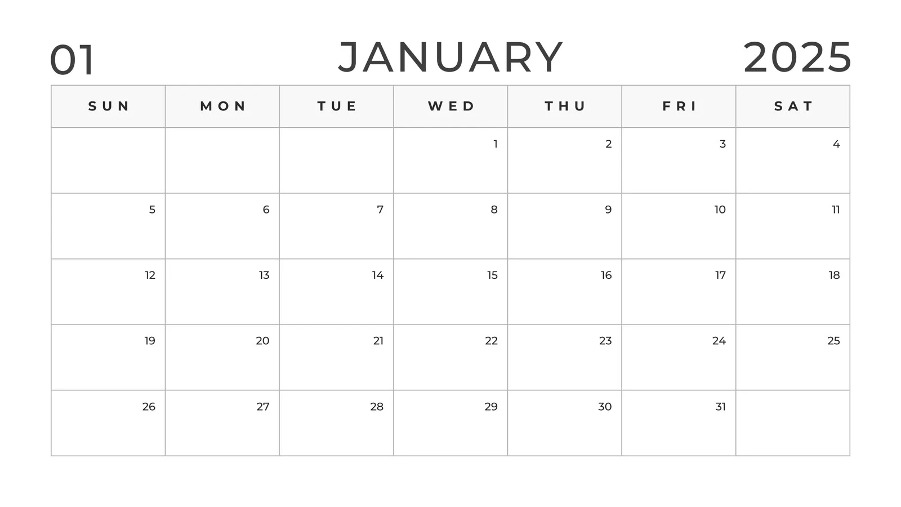
Calendar Component
Monthly grid view
Selection for other months will be above
The current month will be the default one shown
The tasks shown will have one of the four priorities (white, orange, red, or green)
Clicking any day on the calendar will show all the tasks assigned to that day
Tasks will be automatically be “Unassigned” until the users assigns a due date for that specific task

Slide 15
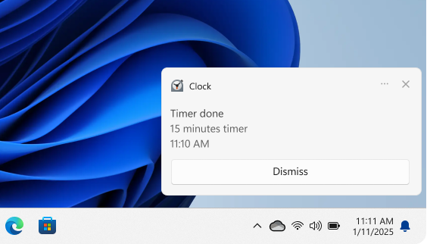
Notification System
24 hours before due dates
Audible alert
Title and Task
Notify when the time is changed by Daylight Saving Time begin
Notes:
Slightly change the order of the slides?

Slide 16
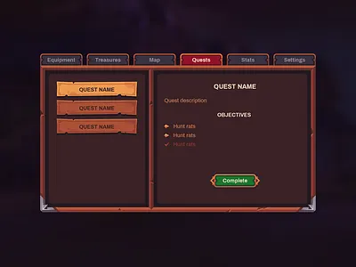
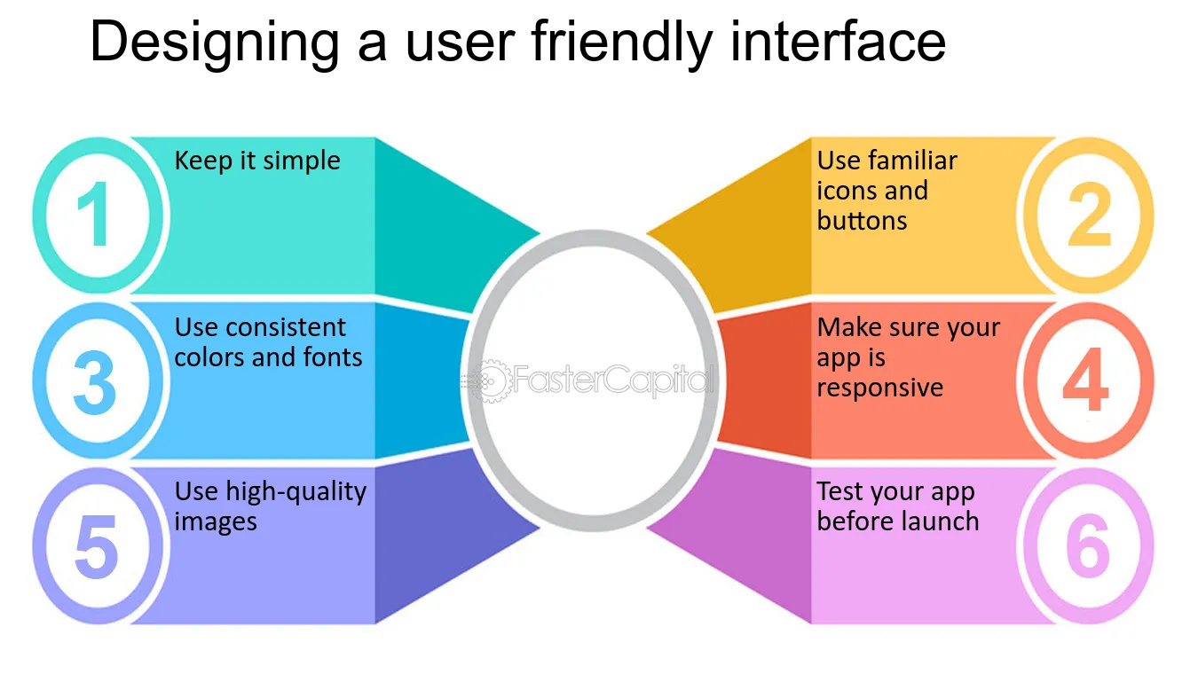
Design
Entertaining elements
Replace the word task with quest
Quest Rewards - 30 minute break, snack time, Play video games
Encourage users to enter the work zone comfortably.

Slide 17
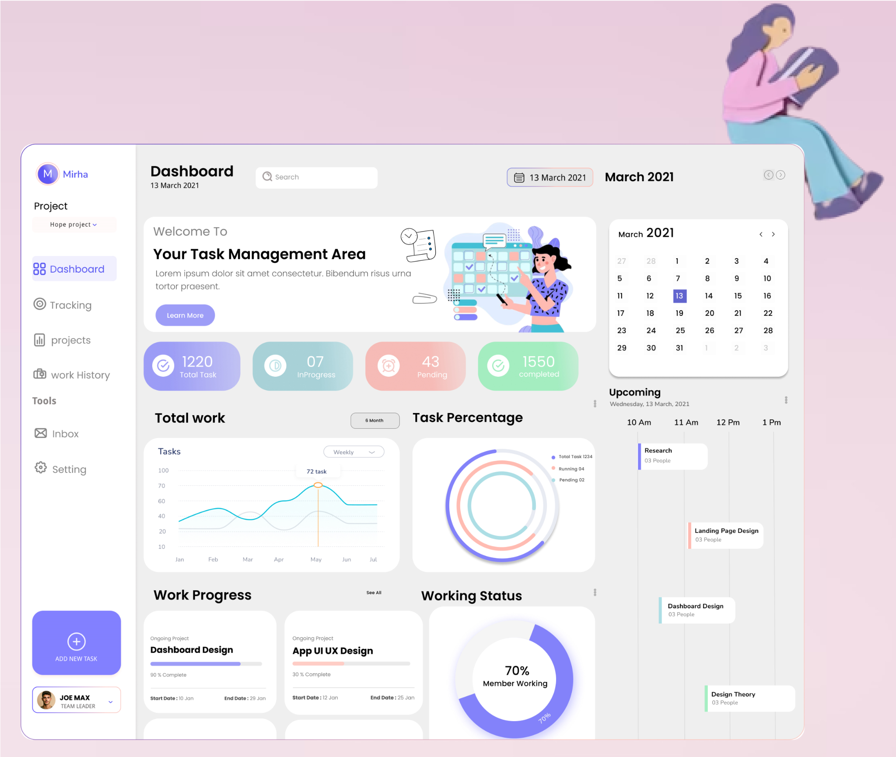
Notes:
Good design example

Slide 18
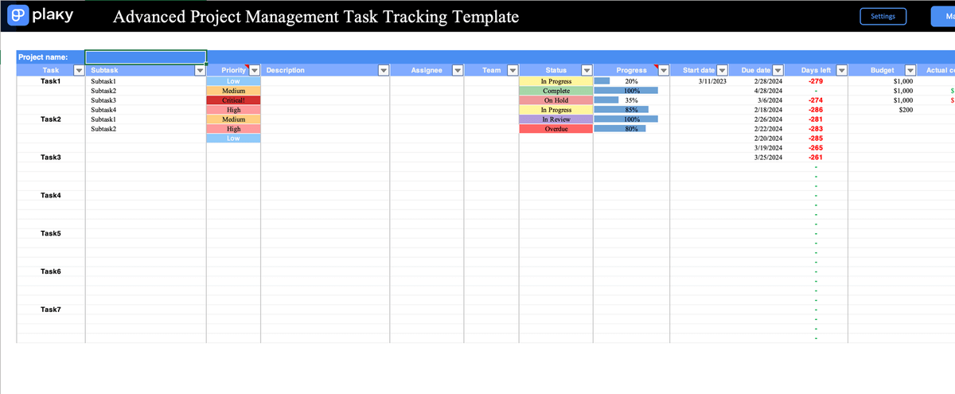
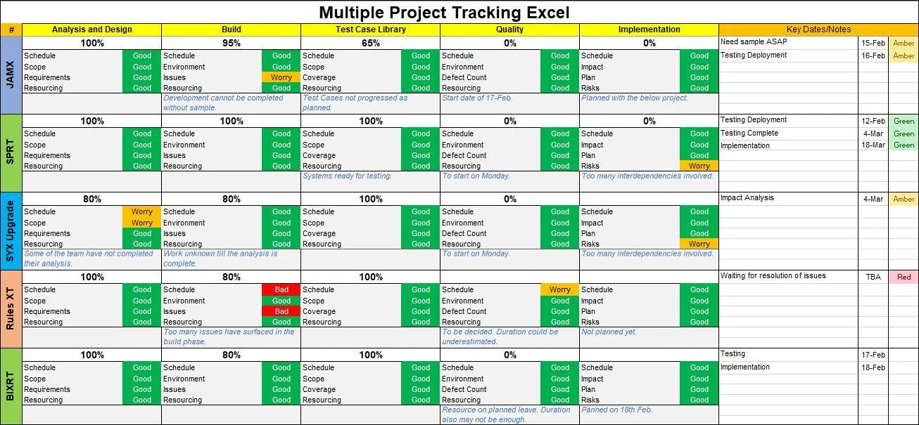
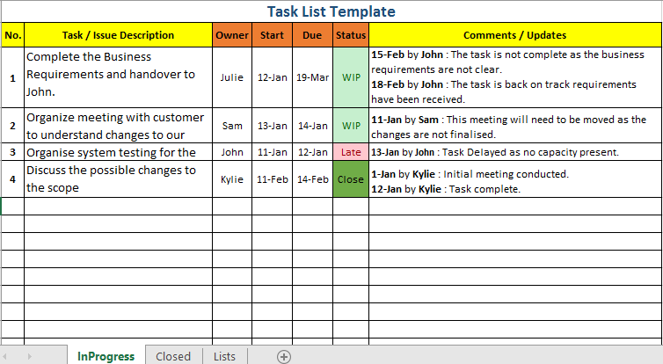
Unacceptable Design Examples

Slide 19
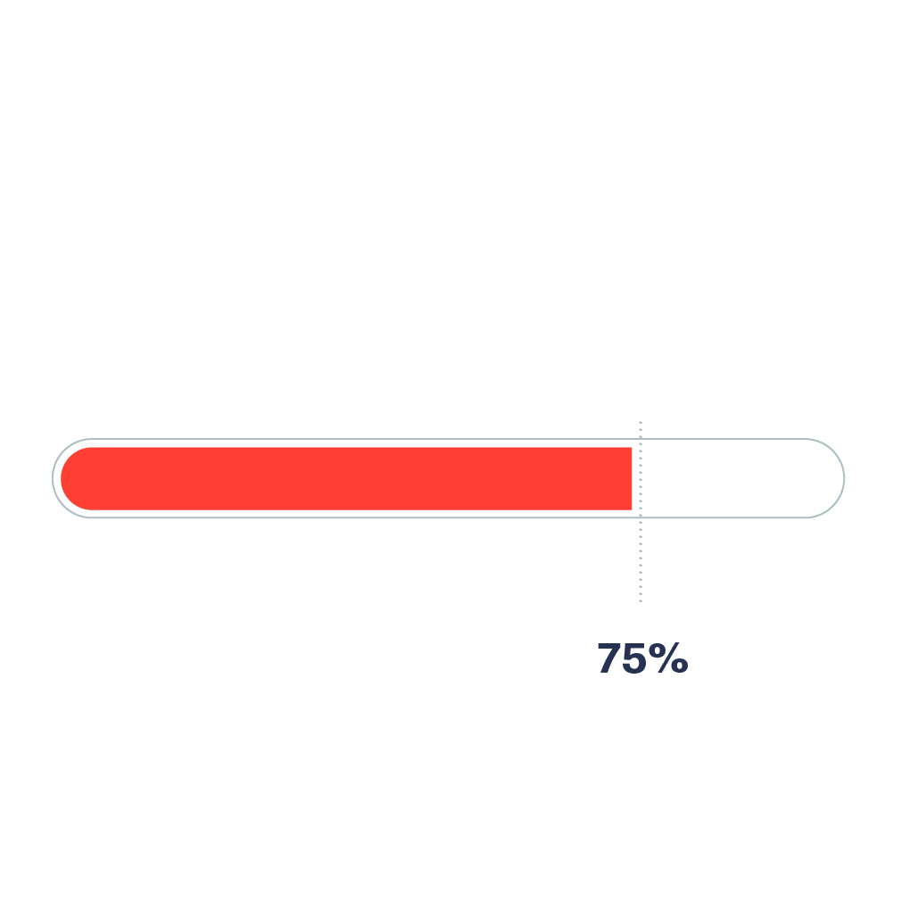


Dashboard
A completion bar to show the user’s progress.

Slide 20

Roles & Permissions
Every user can be assigned a role from the creator (“Founder”) of that specific Blueprint
These roles are Manager and User
Managers will have full “Create, Read, Update, and Delete” privileges or (CRUD) for every tasks and members under the Blueprint
Users can update their own assigned tasks and view the project’s overall status

Slide 21
Tentative Schedule
Week 1: Feb 9-15
Finalize requirements document, initialize GitHub, and setup Supabase and Vercel
Week 2: Feb 16-22
Begin the front end with React and configure the database with Supabase
Week 3: Feb 23-Mar 1
Implement Google OAuth and begin laying out the dashboard
Week 4: Mar 2-8
Create the task list, calendar components, and hooks for the database
Week 5: Mar 9-15
Implement the task list and calendar and begin making the logic for the completion bar
Week 6: Mar 16-22
Create and implement the notification system, implement roles, and test for bugs
Week 7: Mar 23-29
Conduct an overall assessment of the website and fine tune the website with “Past Tasks”
Weeks 8-12: March-May
Create and implement gamification and ChatGPT API call, if time permits

Slide 22

Conclusion
Blueprint is the solution to group projects being hard to manage and there simply being too many project management tools out there that aren’t simple enough for an academic environment
Blueprint will be simple and easy-to-use, catering specifically to students
We will be using React, Supabase, Vercel, and Figma to do this
If time permits, we will implement gamification affects and an API call to Chat GPT to make suggestions for the user

Slide 23
Questions?

